Slide 1

LED Market Assessment and Lighting NTG Study
June 22, 2015
Presented by:
Lisa Wilson-Wright (NMR)
With support from:
Jason Christensen (Cadmus)
Scott Reeves (Cadmus)
Christopher Dyson (DNV GL)
Michael Strom (NMR)
David Barclay (NMR)
Kiersten von Trapp (NMR)

Slide 2
Evaluation Tasks
Task 1: Demand Elasticity Modeling
Task 2: Supplier Interviews*
Task 3: Reanalysis of Saturation Data, Comparison to other Areas*
Task 4: Point-of-Sale (POS) Data Modeling*
Task 5: Overall Reporting
*Leverage resources with MA

Slide 3
Task Leaders
Task 1: Demand Elasticity Modeling
  Cadmus: Scott Reeves, Jason Christensen
Task 2: Supplier Interviews
  DNV GL: Chris Dyson
Task 3: Saturation Reanalysis
  NMR: David Barclay, Kiersten von Trapp
Task 4: POS Data Modeling
  NMR: Michael Strom

Slide 4
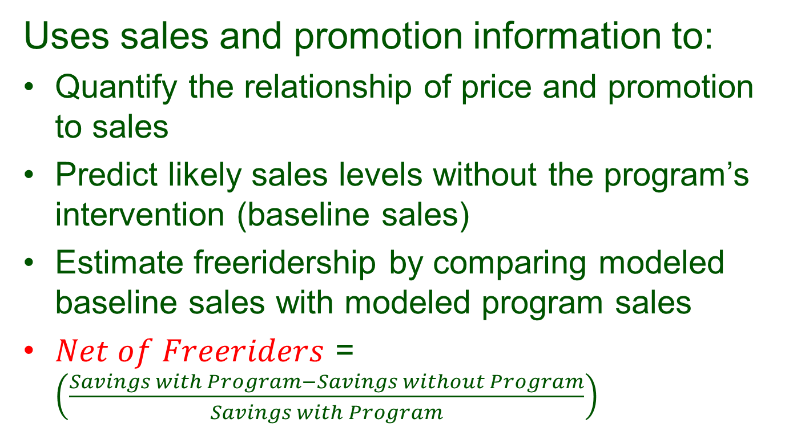
Task 1 Demand Elasticity Model: Objectives
Uses sales and promotion information to:
Quantify the relationship of price and promotion to sales
Predict likely sales levels without the program’s intervention (baseline sales)
Estimate freeridership by comparing modeled baseline sales with modeled program sales
$Net of Freeriders$ = $\left(\frac{Savings with Program−Savings without Program}{Savings with Program}\right)$

Slide 5
Task 1 Demand Elasticity Model: Data Sources
Data provided by implementer APT/CLEAResult:
Program and non-program price
Variation in price over time
Data on external factors that affect price (e.g., specialty/standard, wattage, manufacturer, retailer, LED/CFL)
Tracking data for merchandising/marketing activity

Slide 6
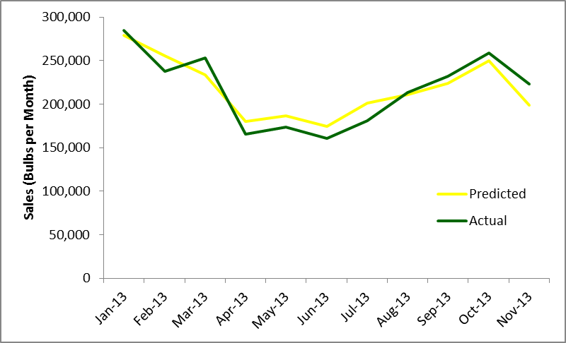
Demand Elasticity Predicted and Actual Sales

Slide 7
Task 1 Demand Elasticity Model: Net of Freeridership Estimate
Company | Net of Freeridership
LED Specialty | 71%
LED Standard | 49%
CFL Specialty | 47%
CFL Standard | 51%
Specialty CFL Net of FR lower than standard
  Less elastic, less competition from halogens
Uncertain why LED standard smaller than expected
  May reflect purchases by early adopters
Notes:
Note that not because of treatment of LED downlights. Maybe also because early adopters buying – not directly tested.

Slide 8
Task 1 Demand Elasticity Model: Benchmarking
Recent studies have standard CFL range of 51% to 83%
  CT is on low end of scale, but…
  Programs included differ in duration, history, level of support
  CT Net of FR actually relatively low compared to incentive offered
  Highest Net of FR incented 63% of bulb price compared to 26% in CT
  CT incented bulbs with greater elasticity, achieved superior net lift relative to incentive budget

Slide 9
Task 2 Supplier Interviews: Objectives
Estimate NTG ratios for supported lighting products
Understand supplier perspectives on the program
Describe state of the market

Slide 10
Task 2 Supplier Interviews: Methodology
In-depth interviews:
  12 lighting suppliers (93% of 2013 program sales)
  4 high-level lighting buyers (34% of 2013 program sales)
  Conducted May-July 2014 in conjunction with MA
Connecticut specific topics:
  NTG estimates
    Change in EE bulb sales absent program discounts
    By bulb type for program, retail channels
  Levels of satisfaction with CT lighting program
  Recommendations for program improvements

Slide 11
Task 2 Supplier Interviews:
NTG Estimates
Bulb Type | NTG Ratio
Standard CFLs | 68%
Specialty CFLs | 55%
LEDs | 74%
NTG dominated by reliance on big box stores
NTG lower for specialty CFLs than standard

Slide 12
Task 2 Supplier Interviews:
Program Satisfaction
Very positive feedback on program staff
Supplier/retailer recommendations for program improvements
  Longer program duration
    Three-year program rather than year-to-year
  More flexibility in RFP
    Bring in new retailers/promotions mid-year
  More funding for program incentives
    Most participate in both MA and CT programs and indicated that MA program had better incentives

Slide 13
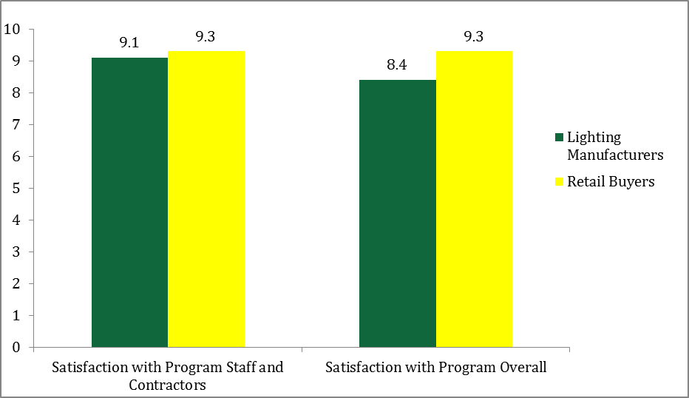
Task 2 Supplier Interviews: Program Satisfaction

Slide 14
Task 2 Supplier Interviews:
National LED Market Trends
LED prices expected to decline
  Greater supply, EISA
  Technology, manufacturer changes
  Do not expect LED fixture prices to drop
LED sales “healthy”
High cost remains barrier to adoption
Rebates, consumer education seen as best ways to increase adoption

Slide 15
Task 3 Saturation Reanalysis:
Objectives
Use prior saturation data (2009, 2012, 2013) to interpolate and extrapolate likely saturation rates in 2010, 2011, and 2014
Compare saturation data in Connecticut with data collected from Eastern Kansas and Georgia in conjunction with Massachusetts

Slide 16
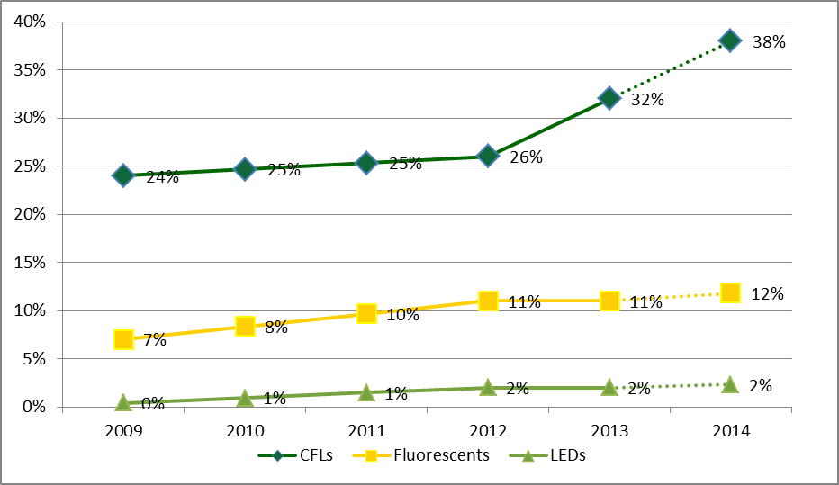
Task 3 Saturation Reanalysis: Efficient Bulb Saturation Over Time

Slide 17
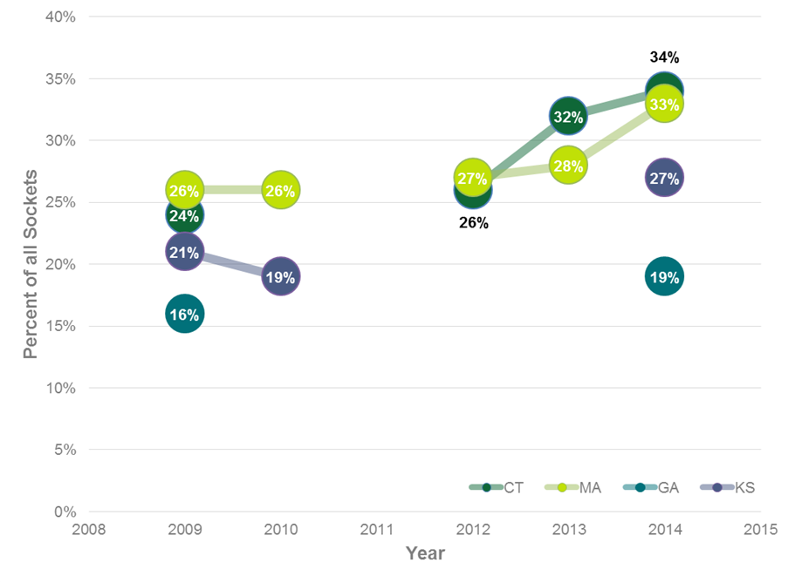
Task 3 Saturation Reanalysis:
Lighting Comparisons
*CT 2014 is forecasted

Slide 18
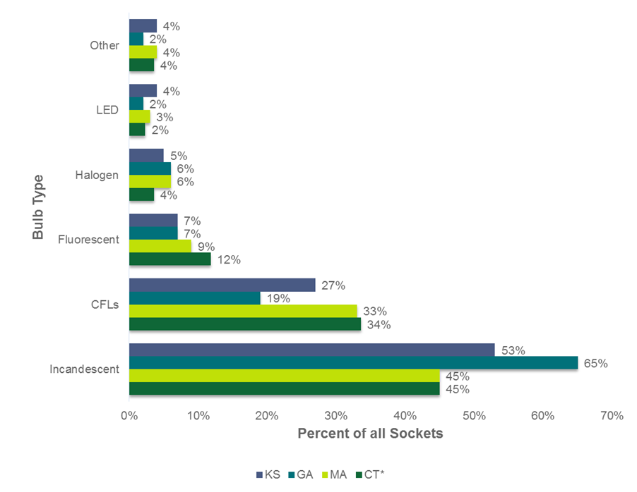
Task 3 Saturation Reanalysis:
Saturation by Bulb Type
*CT 2014 is forecasted

Slide 19
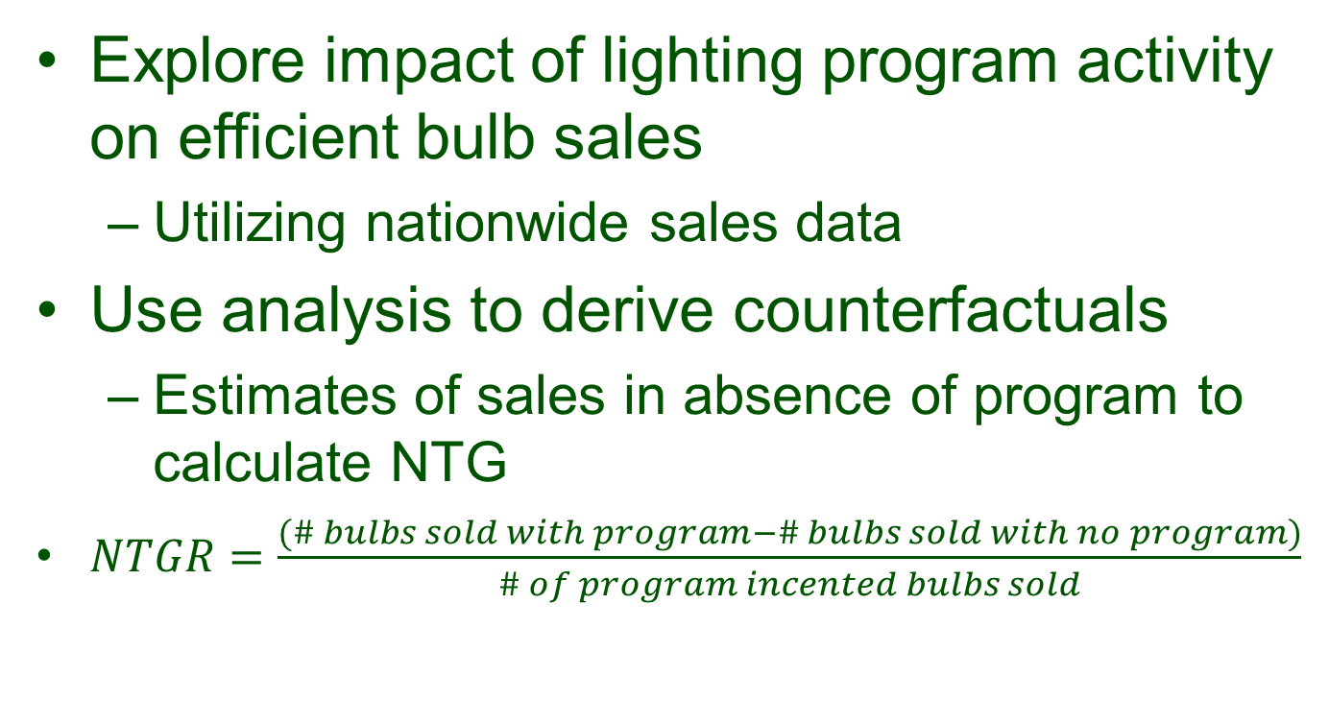
Task 4 POS Modeling:
Objective and Background
Explore impact of lighting program activity on efficient bulb sales
  Utilizing nationwide sales data
Use analysis to derive counterfactuals
  Estimates of sales in absence of program to calculate NTG
$NTGR=\frac{(\# bulbs sold with program−\# bulbs sold with no program)}{\# of program incented bulbs sold}$

Slide 20
Task 4 POS Modeling: Inputs
Series of state-level regression models predicting:
  Proportion of reported bulb sales that were efficient
Model inputs:
  Sq. Ft. of major reporting and non-reporting retail channels
  Demographic variables of interest
  Program activity variable
  % efficient sales in non-program states

Slide 21
Task 4 POS Modeling:
NTG Ratio Estimates
Product | NTG
CFLs | 29%
LEDs | 87%
Dataset covers only 19% of program sales – inclusive of CFLs and LEDs (so smaller for LEDs)
  LEDs very small part of market in 2009, different types of bulbs
  Most general service LEDs sold through channels not in dataset
Dataset does not distinguish specialty from standard
Modeled relationship between budget, % efficient sales
  States with larger budgets show higher NTG

Slide 22
Summary of Net-Freeriders /
Net-to-Gross PY 2013
Measure | Company Assumptions | Task 1: Demand Elasticity | Task 2: Supplier Interviews | Task 4: POS Modeling
LED Specialty | 100% | 71% | 74% | 88%
LED Standard |  | 49%
CFL Specialty | 81% | 47% | 55% | 29%
CFL Standard |  | 51% | 68%
Notes | From the 2014 PSD, Appendix 3; net realization rates are 82% for LEDs and 51% for CFLs | Net of freeridership, partial or missing data required team to make assumptions for some products, stores | Subject to biases of responding manufacturers and retailers | Partial market estimate, home-improvement/hardware channels not included. Limited applicability for program LEDs
Notes:
PSD has installation rate at 63% for CFLs and 82% for LEDs; FR = 19% for CFLs, 0% for LEDs, 0% spillover for both. Values quoted in the draft report were in correct – they were the net realization rate.

Slide 23
Recommended NTG
NTG = 51% for CFLs for 2013
  Estimated values coalescence at this level
NTG = 82% for LEDs for 2013
  Higher than estimated values but none offered strong estimates for LEDs
Expect CFL NTG to stay stable
  Competition from halogens, LEDs
Expect LED NTG to stay high through 2015, but start dropping quickly around 2016
  Declining prices, consumer acceptance

Slide 24
Other Recommendations
Estimate NTG regularly for next few years
  Include estimates for channels (especially hard-to-reach)
  Include estimates for specialty and standard LEDs
  Period of rapid change, uncertainty
  MA developed from multiple methods, consensus building process to produce retro-/ prospective values

Slide 25
Other Recommendations
Continue practice of gradual increase for LEDs, phasing out of CFLs
  But not too fast!
Consider shifting some support from home improvement to other channels
  DIY generally have low NTG compared to others
Cease specialty incentives
  Companies already planning this
Increase LED awareness
  Through current, expanded education, outreach

Slide 26
Plans for 2015 Lighting Study
Goal: Assess trends in lighting market
  Emphasize updating information to reflect current (and trending) LED market
  Provide values that can be incorporated into savings estimates, future plans, PSDs
Study objectives:
  Estimate of efficient socket saturation, bulb penetration
  Provide data on baselines, delta watts
  Provide customer, equipment, market data in support of program targeting, planning

Slide 27
Two Tasks
Task 1: Consumer recruitment survey
  n=150 residential customers
  Check-in on key market indicators
  Recruit for on-sites
Task 2: On-site saturation visits
  n=75 (or more if possible)
  Determine socket saturation, bulb penetration, bulb storage (all types)
  Collect info on delta watts
  Understand consumers lighting purchases

