Slide 1

Connecticut X1932
Demand Response EM&V Support
Project Kickoff
Yogi Patil, Nicole Rosenberg - NMR
Jesse Smith, Adriana Ciccone - Demand Side Analytics
Tom Ledyard, Ken Agnew - DNV-GL
May, 2020

Slide 2
What kW reductions are realized by DR programs?
How do DR programs fit in to existing EE efforts?
Are any changes to research questions or methods recommended for the studies?
How can the DR programs be expanded to a broader group based on pilot evaluation results?
Study Objectives

Slide 3
Kickoff and Evaluation Plan
Data Request & Documentation
Program Monitoring & Feedback
Analysis and Reporting
  Residential Connected Thermostat
  Residential Heat Pump Water Heater
  Large Commercial Geo-Targeted DR
Tasks

Slide 4
Program Name | Implementer | # Event Days in 2019 | 2020 Budget | Number of Participants | Enrolled Capacity (MW) | Baseline Used to Estimate Impacts | Plans for Expansion or Other Status Information
Peak Time Rebates | Bidgely | 2 Events | N/A | 10,000 | N/A | ISO-NE MTOT | This pilot has expired
Connected Thermostat | Energy Hub | 8 Events | $1.37M | 2,700 | 2.1 MW | ISO-NE MTOT Weather Adjusted | Will be a full program in 2020
Heat Pump Water Heater | Energy Hub | 5 Events | Included in the above | 66 | 0.005 MW | ISO-NE MTOT | Will remain a pilot
C&I Geo Targeted | Honeywell | 4 Events | $283k | 3 customer sites (pilot) | 2.6 MW | ISO-NE MTOT Weather Adjusted for weather sensitive measures | Will be a full program in 2020
Residential Room AC | Think Eco | 0 Events | N/A | - | - | - | This pilot has expired in 2018
Program Summary

Slide 5
The ability to accurately measure demand reductions depends upon
  The effect or signal size. It is easier to detect large changes than it is to detect small ones. DR impacts on event days are generally large
  Inherent data volatility. It is hard to detect small changes within volatile loads.
  The ability to filter out noise. All statistical models – no matter how simple or complex – are tools to filter out noise and allow the effect to be more easily detected.
  Population size. It is easier to precisely estimate average impacts for a large population than a small one.
  Available data. Whole-house interval data provides a different set of data than thermostat runtime data, which requires a connected load assumption. Demand response cannot be accurately measured with monthly billing data.
Impact Analysis

Slide 6
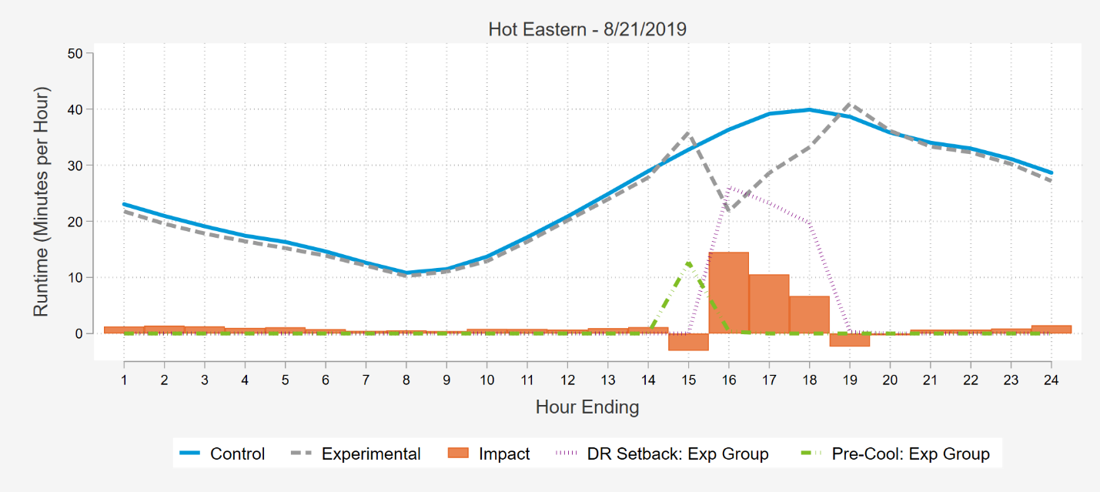
Ex post estimates
Involves understanding what programs provided during summer 2020
Involves estimating a counterfactual – what participants would have done had an event not been called
  Baseline approach
  Within subjects regression
  Matched control group
  Experimental/randomized control group
Impact Analysis
Ex ante estimates
Provide an estimate of program capability under planning conditions
  Weather normalized
  Match dispatch conditions
  Time-temperature matrix
Notes:
Graphs pulled from eco+ public report

Slide 7
Increasing Complexity, /Validity, Data Needs
X-of-Y Baselines
Within-Subjects Regression
Matched Control Group
Randomized Control Group (Alternating Treatment Design)
Evaluation methods can vary depending on available data
  AMI penetration for residential customers
  Ability to extract all participant data? Ability to extract non-participant data?
For devices with built-in end use runtime metering
  Runtime data is available for thermostats. Aggregated or device-level? What about water heaters?
Summary of Available Data

Slide 8
Program Details
  2,700 participants.
  Multiple thermostat manufacturers aggregated by EnergyHub
  Consistent dispatch strategy with 2 hour event
  Pre-cooling prior to event
  4-degree setback
  Assumed 3.5 kW connected load
  Baseline is 10-of-10 MTOT
Evaluation Strategy
  Ex Post
    Will depend on available data
    Ideally collect both tstat runtime & AMI
    Control groups provide additional precision
  Ex Ante
    Time-temperature matrix based on dispatch conditions
Connected T-stat

Slide 9
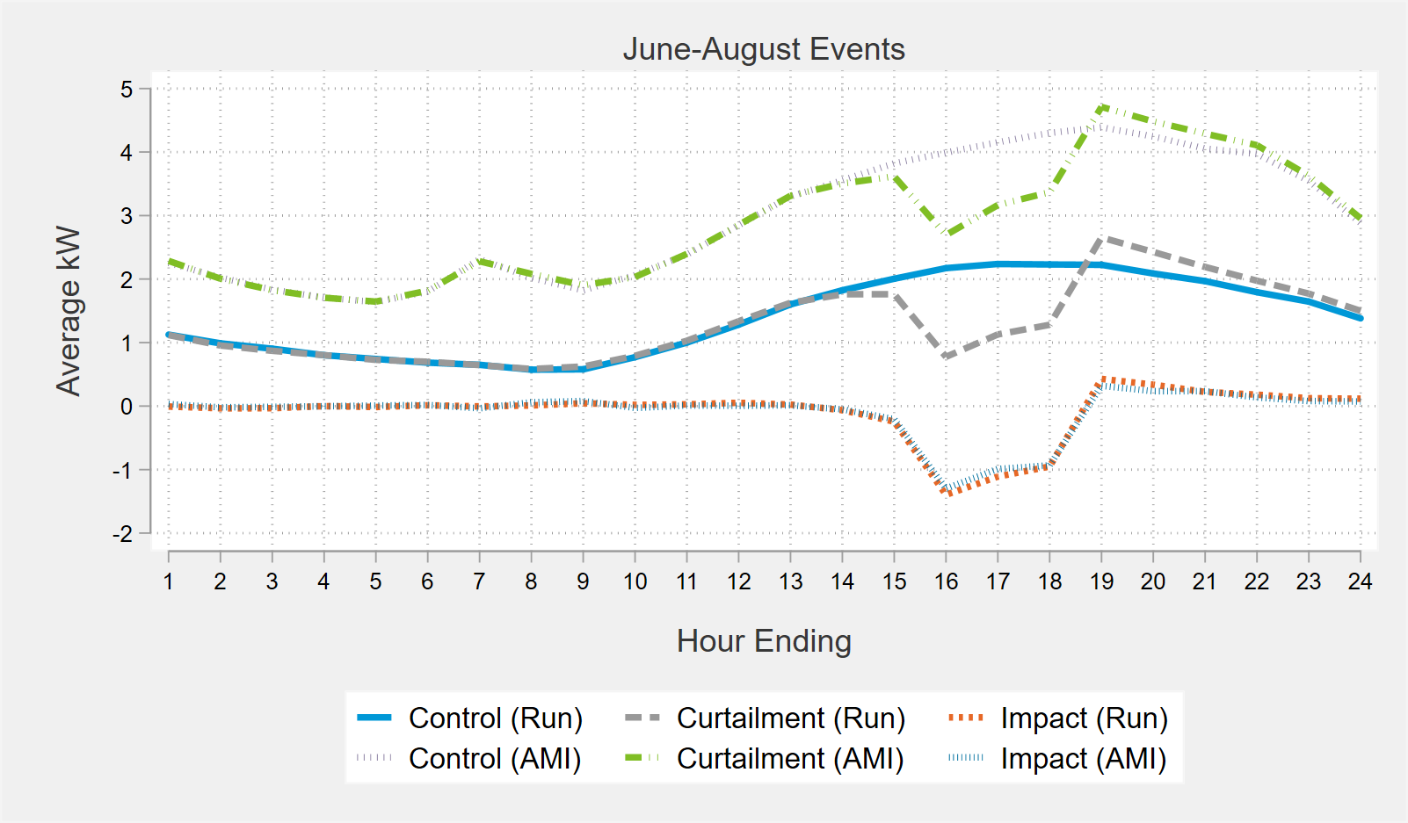
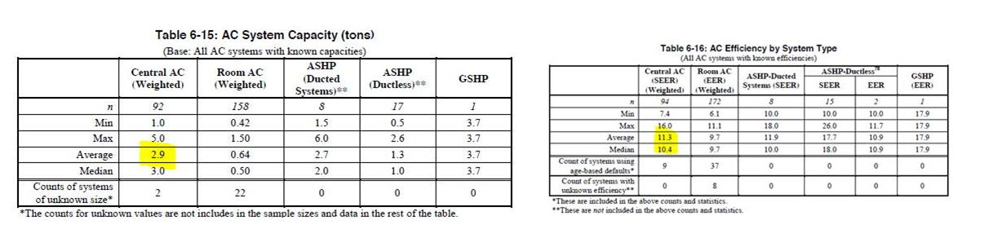
EnergyHub and UI currently assume 3.5 kW
  To convert AC runtime to demand. Is that appropriate for UI service territory?
  With runtime and AMI data we can validate. Estimate impacts with both data sets and solve for the connected load assumptions that provides the same impacts (figure to the right)
  Leverage baseline studies to estimate (tables below)
Connected Load

Slide 10
Program Details
  66 participants
  Dispatched in winter and summer
Evaluation Strategy
  Ex Post
    Leverage runtime data for evaluation
    May reference load data collected in other territories
    Control groups provide additional precision
  Ex Ante
    Predict under dispatch conditions
Heat Pump Water Heater

Slide 11
Program Details
  3 customers
  Dispatched in winter (up to 6 events) and summer (up to 12 events)
Evaluation Strategy
  Ex Post
    Adjusted and unadjusted 10 of 10 baselines
    Within-subjects regression approach
  Ex Ante
    Predict under dispatch conditions
C&I Demand Response

Slide 12
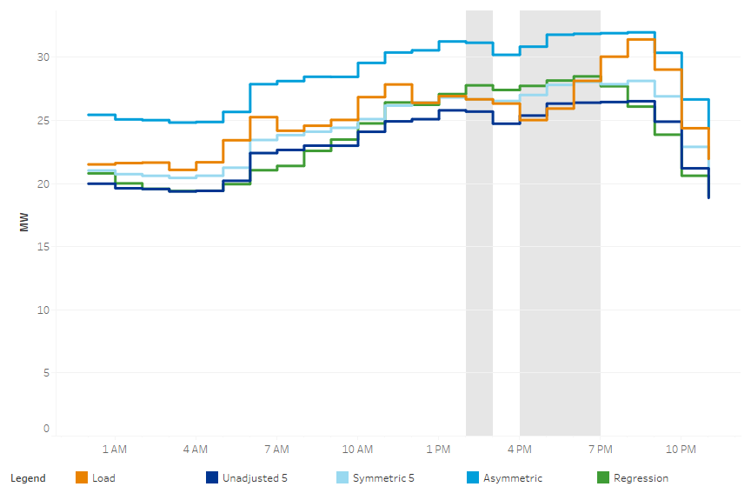
Determine settlement Baseline specifics, compare to alternatives
  Adjustment period
  Symmetric adjustment?
Assess implications of solar generation in net metered AMI data
Assess suitability of regression-based estimates
  Adjustment shutdown behavior Symmetric adjustment?
  non-weather related variability
C&I Demand Response

Slide 13
The role of DR is still developing in Connecticut. Key issues elsewhere:
  Shift in the focus of planning and operations. From gross to net loads
  Increased need for fast response resources. Follow net loads and counterbalance variability in renewable resources
  Changes in the timing. For when system net loads peak
  Increased need for resources to sustain variations in net loads. For longer and larger sustained upward and downward ramps in net loads
  Over-generation. During the middle of the day, particularly on weekends in spring and fall months
How can UI capture value from DR resources?
  Valuation of generation capacity for a distribution company when generation supply is competitive.
  What value can DR provide UI in the short and long term?
    ISO-NE vs NYISO
  How can dispatch strategy be designed for different grid applications?
  How can UI get credit for providing DR resources?
Other Support Tasks

Slide 14
Budget & Timeline

Slide 15
Q & A
Questions?

