Slide 1

Connecticut C1902
ECB NTG and Baseline and Upstream Non-Lighting NTG Study
Kick-Off Meeting
Yogi Patil, NMR
Nicole Wobus, Lynn Roy, Wyley Hodgson, BrightLine Group
Tom Ledyard, Shawn Bodmann, Miles Ingram, DNV
March 30, 2021
Notes:
To insert an image, click the image button and select your picture.

Slide 2
Overview and Objectives
Initial Research Tasks
Primary Data Collection
Analysis, Reporting, and Final Presentation
Schedule
Agenda

Slide 3
Study covers 2 programs/initiatives, and a variety of C&I evaluation research areas.
Programs/initiatives covered:
  Energy Conscious Blueprint (ECB):
    True new construction (TNC)
    Replace on failure (ROF)
  Upstream Non-Lighting initiatives:
    Primarily ROF
    Measures offered include HVAC, food service & refrigeration
Evaluation research areas covered:
  Market baseline practices
  Net-to-gross (NTG) ratios
  Code compliance
Overview & Objectives
Notes:
This project addresses a variety of evaluation research needs related to non-residential energy efficiency markets, leveraging efficiencies across data collection activities.
Specifically, the project will address:
New construction – program attribution: We will assess the net-to-gross ratio, or “NTG,” for the Energy Conscious Blueprint (ECB) program (i.e., the extent to which energy savings counted for the program are attributable to program activities).
Market baseline efficiency for new construction and equipment replacements: We will identify standard market practices for specifying energy efficiency.
New construction – code compliance: We will research what percentage of new construction complies with the building code.
Upstream non-lighting – program attribution: We will estimate NTG for the program that leverages equipment distributors to increase stocking and availability of efficient HVAC and food service products.

Slide 4
ECB Baseline & NTG
Update measure-specific baselines & end-use specific NTG for TNC* & ROF**
Improve accuracy of gross & net savings estimates to align with market conditions
Code Compliance
Measure Code compliance rates for TNC* projects
Upstream Non-Lighting NTG
Determine C&I upstream non-lighting NTG by measure category
Assess targeted process elements of upstream program
Develop NTG values reflecting planned program changes going forward
Provide a reference for future code compliance efforts
Overview & Objectives
*=True New Construction; ** ROF=Replace on failure

Slide 5
Study design gives special consideration to 2020/21 ECB program changes.
  Shifted to 4-pathway program format with increased emphasis on whole building projects.
  Evaluation results are forward-looking and must reflect the shift.
  Focusing analysis on current program paths that best align with previous program format.
  Evaluation uses 2019/2020 Q1 market and new construction project data to inform forward-looking NTG ratios.
Overview & Objectives
Prior Program Structure | Current Program Structure
N/A | Path 1. Zero Net Energy / Deep Energy Savings (EUI focus)
Whole Building Performance & Zero Net Energy Modeling Program | Path 2. Whole Building Energy Use Intensity (EUI) Reduction—larger buildings
N/A | Path 3. Whole Building Streamlined—small to medium buildings
Prescriptive Program (incentives for multi-end use, lighting, custom & prescriptive equipment) | Path 4. Systems—small / simple equipment and systems projects
Notes:
Commonalities from old / new format: tech. assistance, early design intervention

Slide 6
Overview of Project Tasks
  Workplan Development and Kickoff
  Review of Program Data
  Literature Review
  Primary Data Collection
    Baseline-Focused Activities
    Code Compliance-Focused Activities
    ECB NTG-Focused Activities
    Upstream Non-Lighting NTG-Focused Activities
  Analysis and Reporting
Overview & Objectives

Slide 7
Program & Other Data Review
Data requests
  Tracking data
  Customer data
  Program materials
Data / program material review
  Current program tracking /customer data
  Dodge data on new construction projects in CT
  Supplement & verify Dodge data with utility data
T2: Initial Research Tasks

Slide 8
Literature Review
Purpose:
  To inform methods and focus scope on highest priority measures and research areas
Studies for review include:
  Recent ECB impact evaluation (C1634)
  C&I baseline/potential studies from other jurisdictions
  Code compliance studies
  Recent C&I new construction NTG studies
  Recent NTG methods best practices
  Upstream non-lighting NTG studies
T3: Literature Review
Notes:
Reviewing research approaches, findings and challenges from other similar studies will provide insight into best practices and help us hone study activities.
When reviewing literature we will consider appropriateness of research to CT
Study timing, rate of technology advancements, etc.

Slide 9


Activity | Target Completes (n) | Baseline | Code Compliance | ECB NTG | Upstream NTG
General population surveys | 325
Literature studies/review | N/A
Market Actor IDIs
Architects / modelers / eng. | 10
Distributors | 3 baseline; up to 30 upstream NTG
Contractors | 3
Code officials / C&S committee | 2
Manufactures | 2
Program staff IDIs | 3
Implementation vendor IDIs | 3
Participant surveys (NTG) | ECB = 125; Upstream = 70 contractors, 70 customers
Expert panel | 20
Includes ROF; “IDI” = in-depth interview
T4: Data Collection
Notes:
Non-residential baseline study activities will be the foundation and primary thread that integrates all study components.
Two separate NTG analyses and a code compliance study will integrate with the baseline study.
Not necessary to measure ROF NTG for ECB since the program is already shifting focus to whole building new construction
Cross-cutting market actor interviews: would include energy modeling firms, architects, engineers, contractors
Not shown here – program staff interviews, Comcheck

Slide 10
Data Collection Topics
Market Actors (n=20)
Market for end-use equipment installations
C&I Web Surveys
(N=325)
Measure-specific questions to calculate standard practice baselines
Obtain / review building plans / follow-up calls to clarify web survey results
Virtual Surveys / Verifications
(n=15-20)
Onsite (with PPE) or virtual, 2-4 hours, incentive
Building Dept Visits
Industry standards & baseline variations
ECB program awareness and participation
Call in option / incentive
Photograph equipment, bldg. plans, nameplates,
Verify key characteristics
Obtain building plans
Decision-making process
Willingness to install EE end-use equipment
Qualitative feedback
T4a: Data Collection – Baseline

Slide 11
Expected Measure Breakdown
PSD C&I Lost Opportunity Measures
End Use | Measure Chapter | Sample
Lighting | Lighting* | 30+
HVAC & Water Heating | Chillers | 30
 | Unitary AC & Heat Pumps | 30+
 | Water & Ground Source Heat Pumps | 30
 | Demand Control Ventilation | 30
 | Natural Gas Fired Boilers & Furnaces | -
 | Natural Gas Radiant Heaters | 30
 | Natural Gas-Fired Hot Water Heaters | 30+
 | Variable Refrigerant Flow HVAC | 30
Drives | HVAC Variable Frequency Drives | 30+
Other | Custom (incl. whole building/EUI) | 30
 | Commercial Kitchen Equipment | 30+
 | Commercial Clothes Washers | 30
T4a: Data Collection – Baseline
We will include lighting controls to reflect the changes to PSD Chapter 2
after discussion with X1931 study team.

Slide 12
Measures Included in C1902 and Other CT Evaluations
PSD C&I Lost Opportunity Measures |  |  | CT Studies
End Use | Measure Chapter | Applicable Code or Baseline in 2020 PSD | Equipment Replacement | New Construction | Upstream NTG
Lighting | Lighting | 2015 IECC | C2014 | C1902 | C1635
 | Lighting Controls | Chapter not in 2020 PSD | X1931** | X1931** | N/A
HVAC & Water Heating | Chillers | 2015 IECC | ** | C1902* | C1902
 | Unitary AC & Heat Pumps | 2015 IECC
 | Water & Ground Source Heat Pumps | 2015 IECC
 | Demand Control Ventilation | Baseline is typically no control
 | Natural Gas Fired Boilers & Furnaces | 2015 IECC | X1931** | X1931**
 | Natural Gas Radiant Heaters | 2015 IECC | ** | C1902*
 | Natural Gas-Fired Hot Water Heaters | 2015 IECC
 | Variable Refrigerant Flow HVAC | 2016 ASHRAE
Drives | HVAC Variable Frequency Drives | Baseline is constant speed equipment | ** | C1902 | N/A
Other | Custom (incl. whole building) | 2015 IECC | ** | C1902 | N/A
 | Commercial Kitchen Equipment | Federal & CA Standard | ** | ** | C1902
 | Commercial Clothes Washers | Federal Standard | ** | ** | N/A
* = measures will be covered within broader HVAC category
** = measure may be included in C1902 depending on baseline sample; will also leverage upstream NTG research where possible
Sample will target representative results for lighting, HVAC systems, HVAC controls, VFDs, and envelope.
T4a: Data Collection – Baseline

Slide 13
Five sources for EUI Baseline Research
Whole building participant projects
  EUI calculations for sampled buildings with complete data
Review simulation models for EUI values
  Assess EUI values from simulation models
Literature review (MA EUI Baseline Enhancement Study)
Expert panel interviews
Market actor interviews
T4a: Data Collection - EUI Baseline
Note: EUI=Energy utilization index (kWh/sqft)

Slide 14
Replace on Failure – 3+ sources
Included in limited capacity
Baseline sample will be TNC
  Dodge data is only TNC
  Participation data will include some ROF projects
Upstream IDIs will be primary source of ROF baseline
  Include questions in market actor IDIs
Supplemented through literature review
  e.g., X1931 natural gas boilers/furnaces study
T4a: Data Collection - Replace on Failure

Slide 15
Code Compliance – 4+ sources
Additional Interviews
  State code officials (C&S Committee members, DEEP/DAS staff)
  Utility code compliance & development program staff
  Attend two monthly CT C&S Committee meetings
Supplement literature review
  Review literature on best practices for code compliance & development activities
Leverage baseline data collection
  Building plans and on-site/virtual surveys & verification of plan documents
  Building dept. visits for construction drawings
COMCheck analysis
  Sample = 42
  Segmentation by building types, county, etc. (may not be statistically significant)
T4b: Data Collection – Code Compliance
2019: Program Year for C1902-sampled projects studied for baseline purposes (permit application date in 2019)
October 2021: IECC 2018 effective
2022-24: Study outcomes used as basis to measure savings attributable to future code compliance activities
October 2018: IECC 2015 effective

Slide 16
ECB NTG-Focused Activities – 3 sources
Participant & Non-Participant surveys (mixed mode)
  Free ridership covering multiple levels of efficiency
  Non-participants (w/ subset of baseline sites)
Market actor IDIs
  Coordinated with baseline and upstream NTG study activities
Expert / Consensus Panel
  Focus on challenge of translating 2019 NTG values to forward looking values that reflect an increased emphasis on whole building projects.
  Recruited in part through market actor interviews
T4c: Data Collection – ECB NTG

Slide 17
Upstream Non-Lighting NTG
2019-2021 C&LM Plan priority to “shift rebates upstream to distributors to drive energy efficiency in specific market sectors”
  Upstream non-lighting NTG has not been evaluated in CT, and current PSD based on 2016 portfolio-level assumptions from MA
Prioritize HVAC & food service measures based on:
  Program data review, staff interviews, findings from studies*, and market actor interviews & surveys (distributor, contractor, end-user)
Leverage NTG questions & methods from on-going MA study
  CT/MA have similar implementation vendors & data format
  Utilize prior MA survey/interview instruments and data cleaning process
  Compare CT/MA results for key differences in markets & programs
T4d:Data Collection – Upstream NTG
* CT HVAC Market Share Assessment (2019), MA C&I Upstream HVAC/Heat Pump and Hot Water NTG Study (2018)

Slide 18
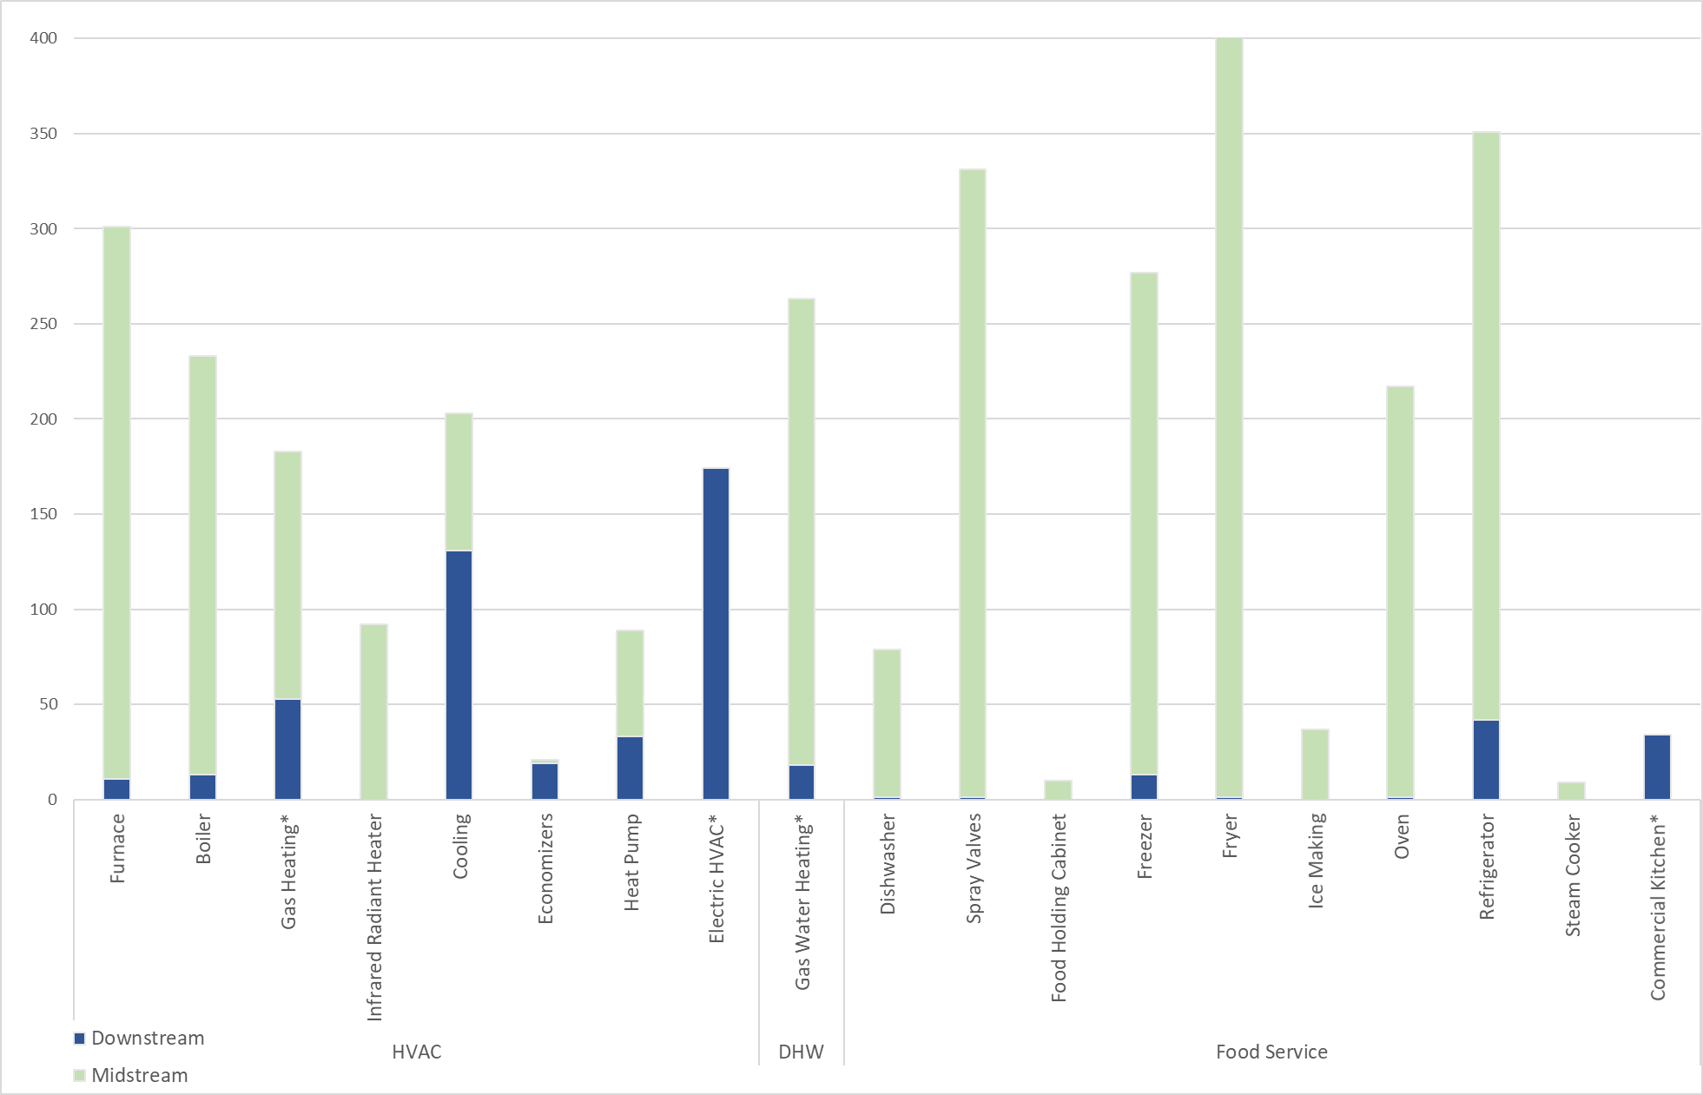
Upstream HVAC and Food Service, Preliminary Summary of Quantities by Measure, 2018-2020
T4d:Data Collection – Upstream NTG
*Measure-level data not yet provided

Slide 19
Upstream NTG Data Collection & Topics
Tracking Data
(census)
Types of equipment supplied / distributed
Mfg, Distributors IDI (active & inactive)
(N=30)
If interviewed in MA, key program/market & FR differences CT/MA
Participating End User Survey
(N=70)
Where end user info available, awareness, influence of distributor promotion & stocking practices on end-user decision-making
Participating Contractors Survey
(N=70)
Staff & Implementer IDI
(N=3)
Current & future initiative design
Initiative awareness
Peer upstream HVAC initiatives review
(N=5)
Initiative review & IDIs from 5 programs, being conducted for MA 20X08-B
Activity level of participating distributors (from # incentives claimed)
Process opportunities
If CT-only, feedback on initiative design, changes, suggestions
If inactive, barriers to participation
Feedback on initiative experience and market event (ER/ROF/NC)
Influence of distributor promotion, price, stocking practices on decision
Feedback on initiative experience & market event (ER/ROF/NC)
Will compare results to CT program design & offerings
T4d: Data Collection – Upstream NTG

Slide 20
Baseline analysis and results
  Analysis of web surveys and building plans, market actor and staff IDIs, expert panel, and literature – used to:
    Update baselines for selected measures reflecting ISP where baseline differs from code
    Recommendations for adjusting application of NTG values to account for the ISP baseline outcomes
Code compliance rate
  Analysis of web surveys and building plans, market actor IDIs, expert panel, COMCheck models, and literature – used to:
    Report 2019 code compliance rate
    Breakdown by building type (not statistically significant)
T5: Analysis & Reporting

Slide 21
ECB NTG
  Analysis of participant surveys, baseline web surveys, market actor / staff IDIs, expert panel, and literature – used to:
    Estimate retrospective and prospective NTG Ratio values using accepted NTG scoring algorithm
    Identify factors that could drive changes in program attribution outcomes
    Provide recommendations for applying NTG outcomes under various forward-looking program scenarios
Upstream Non-Lighting NTG
  Analysis of participant surveys, baseline web surveys, market actor / staff / vendor IDIs, expert panel, and literature – used to:
    Estimate C&I upstream non-lighting NTG by measure category
    Assess targeted process elements of upstream program
Summarize study outputs, compare over time and to other (peer) programs for context, trends, best practices, lessons
T5: Analysis & Reporting
Notes:
ECB NTG - Report at end use level (consistent with what’s in the PSD). Add whole building level.

Slide 22
Task / Output | Schedule | Budget
Kickoff, Data & Lit Review | Dec 2020 – May 2021 | $122,800
Data Collection | Apr 2021 – Dec 2021 | $282,200
Analysis | Jul 2021 – Jan 2022 | $204,800
Reporting | Summer Results for PSD: none Draft For Committee Review – Feb 2022 Final – March 2022 | $70,200
Total | Dec 2020 – Feb/Mar 2022 | $680,000
Schedule & Budget

Slide 23
Questions?

Slide 24
Overview of Approach and Relationship Between Project Elements
MEASURE NON-RESIDENTIAL BASELINE MARKET CONDITIONS
Measure New Construction Code Compliance Rates
New Construction Baseline
Replace on Failure Baseline
Whole Building
End Use -Level
Approach
Energy Conscious Blueprint Program NTG –
Focus: True New Construction Projects, Adapt 2019 data measurement to reflect changing program
(generate end-use and whole building-level values)
Upstream Non-Lighting Program NTG –
Focus: Replace on Failure, HVAC, potentially food service and refrigeration
(generate end-use-level values)
Notes:
Non-residential baseline study activities will be the foundation and primary thread that integrates all study components.
Two separate NTG analyses and a code compliance study will integrate with the baseline study.
Not necessary to measure ROF NTG for ECB since the program is already shifting focus to whole building new construction
Cross-cutting market actor interviews: would include energy modeling firms, architects, engineers, contractors
Not shown here – program staff interviews, Comcheck

Slide 25
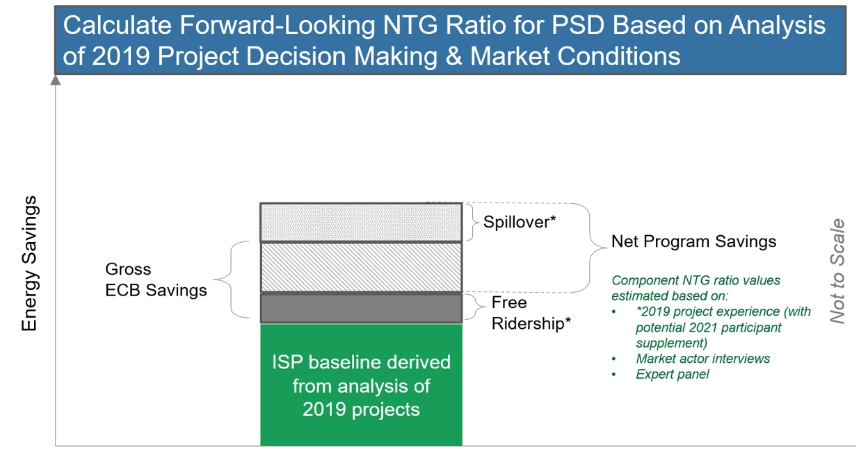
Approach for Using 2019 Market and Project Data to Inform Forward-Looking NTG Ratio Values
T4c:Data Collection – ECB NTG
Notes:
Commonalities from old / new format: tech. assistance, early design intervention

Slide 26
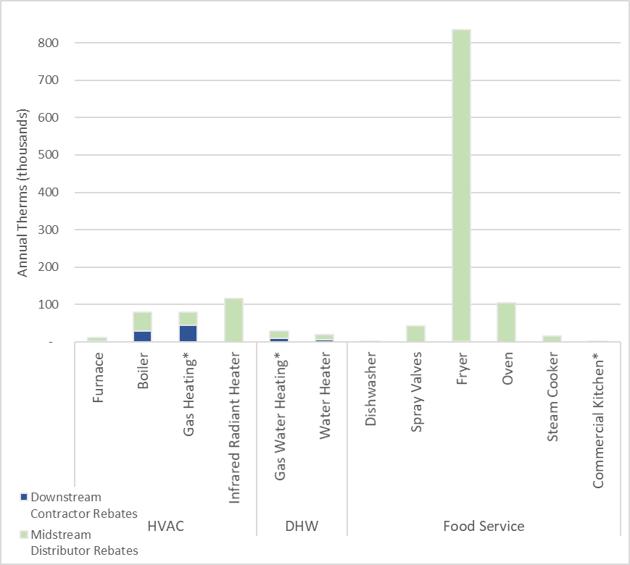
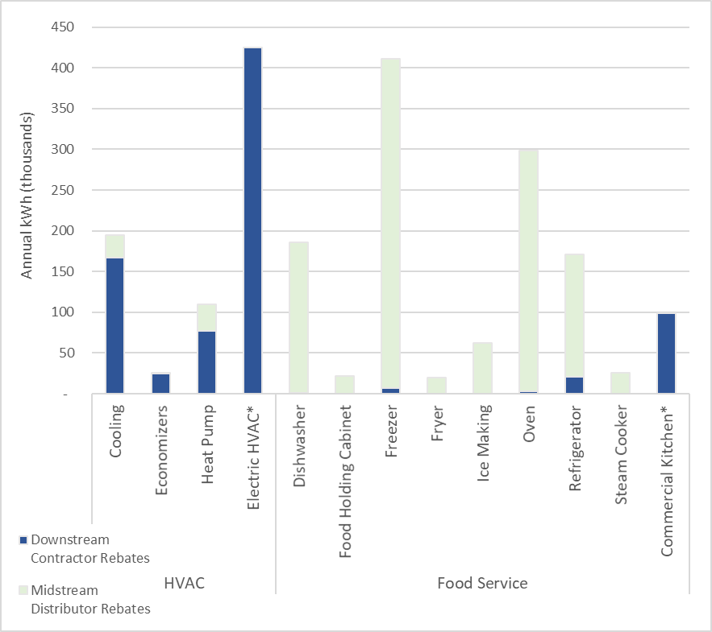
Upstream HVAC and Food Service, Preliminary Summary of Savings by Measure, 2018-2020
Appendix

Slide 27
ECB NTG Data Collection & Topics
Tracking and Other Data, Literature
(census)
Types and characteristics of projects completed
Architect, Engineer, Modeler, Contractor IDI (N=30)
Program awareness among customers
Baseline Web Survey (Non-Participants)
(N=N/A)
Awareness of and participation in ECB program
Participating End User Survey (2019 participants)
(N=125; potentially additional 2021)
Staff IDI (potential)
(N=2)
Current & future initiative design
Questions to drive NTG analysis algorithm; for equipment-specific projects: timing, quantity, efficiency; spillover
Expert Panel
(N=20)
Perspective on participant survey results; how market and program may affect NTG values measured based on 2019 participation.
Insight into program process and relationship to program influence
Understanding of customer decision making and program’s role
Questions tailored to program’s influence on whole building projects
Potential program market effects (influence on market structure)
Program activity relative to TNC market size (review Dodge data)
Customer decision making
Research methods; findings, challenges from similar studies
T4c: Data Collection – ECB NTG

