Slide 1
R1617 Connecticut Residential Ductless Heat Pumps Market Characterization Final Results
Technical Presentation - July 26, 2019

Slide 2
Agenda
Introductions and Attendance
Background
Study purpose
Overview of project tasks and methodology
Key findings
  Baseline
  Energy impacts
  PSD review
  Contractor interviews
  Adoption model
Recommendations and Conclusions
Adoption Model Demonstration Overview

Slide 3



Study Purpose
Study Purpose
Determine DHP savings baseline
Establish the electric and fossil fuel impacts of each baseline condition
Explore the DHP marketplace from the contractor perspective
Develop a tool to estimate market adoption rates under various rebate and fuel cost levels
Provide guidance for documenting DHP impacts in the CT PSD.
Notes:
The previous CT study based on old pilot that were specifically targeted. AND (FOR PLANNING PURPOSES) THE IMPACTS ARE LIKELY NOT REPRESENTATIVE OF NEXT PROGRAM PARTICIPANTS
Baseline is very complicated but has a profound influence on the impacts of a DHP installation. It can cross fuels, requires detailed understanding of whether and how the served space was previously heated or cooled, how the customer is actually using the new unit to heat or cool the served space (which may differ from how they may have intended to use it), and the likely alternative heating or cooling system they would have installed (driven in part by level of awareness of standard DHP alternatives).
DHP technology is rapidly improving, making it increasingly viable in cold climates such as CT and changing its level of use (operating hours),
It is clear that DHPs can be a useful tool to achieve policy goals and this study was intended to provide information to help guide that discussion, PSD revisions to support it, and a tool to help make it happen.

Slide 4
Overview of Tasks and Methodology

Slide 5
Methodology: Baseline Classification
A systematic series of participant questions determined the baseline at the head level. This was designed in collaboration with a working group. This table summarizes the core principles used.
When… | The Savings Baseline is …
1. A DHP head location is currently providing heating or cooling to a space that did not have a pre-existing system (additions, etc.) | The reported technology what would have been installed or no cooling or heating if they would not have installed a system.
2. The respondent reported that had they not purchased the DHP they would have continued to use the pre-existing system to heat the space | The pre-existing system.
3. The respondent indicated that they were no longer going to use their pre-existing system at the time of deciding to install the DHP | The reported technology that would have been installed.
Free riders were removed from this analysis so their tendency to install a program eligible heat pump absent the program does not influence the baseline.

Slide 6
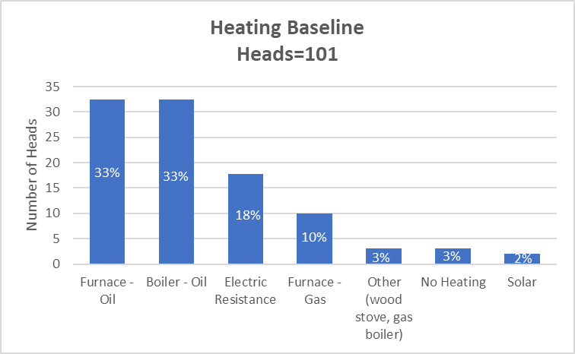
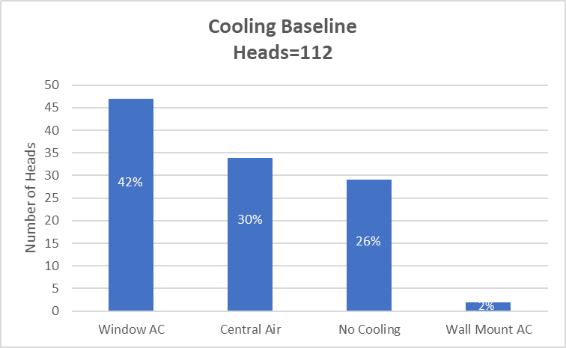
Key Findings: Savings Baseline for 2015-2016 DHP Program Participants

Slide 7
Key Findings: Impacts by Dwelling Unit Type and Intended DHP use
Population Segment | n | kWh Impact (avg per home) | Therm Impact (avg per home) |  |  | Overall MMBtu Impact (avg per home) | Carbon Reductions (metric tons of CO2)*
 |  |  | Overall | Oil | Gas
Multi Family Electric Heat | 1 | 3,185.7 | - | - |  | 10.9 | 0.8
Multi Family Non-Electric Heat | 1 | -1,351.8 | 273 .4 | 273.4 |  | 22.7 | 1.7
Single Family Electric Heat | 8 | 588.4 | 112.9 | 71.5 | 41.3 | 13.3 | 0.9
Single Family Non-Electric Heat, Cooling Only | 12 | -601.9 | 101.9 | 72.9 | 29.0 | 8.1 | 0.5
Single Family Non-Electric Heat, Not Only Cool | 38 | -713.4 | 130.5 | 123.9 | 6.6 | 10.6 | 0.8
Although some categories reflect load building, all categories produce positive MMBtu and Carbon Reduction impacts
*Total equivalent emissions factor used: 0.0003 MT CO2e/kWh (direct kWh savings), 0.007396 MT CO2e/distillate fuel #2 therm, and 0.00531 MT CO2e/natural gas therm
Notes:
Dwelling Unit, whether had electric or non electric heat, whether intended to cool only. Theorized about which categories would make the most sense to look at and settled on these.

Slide 8
Key Findings: PSD Review
The 2019 PSD has two formulas to calculate DHP impacts. They each credit electric savings but not fossil fuel savings.
  The Lost Opportunity Calculation is used to calculate impacts from a fossil fuel home and uses a standard DHP as the baseline (14.0 SEER). This method was reported as used for all upstream units.
  The Retrofit Calculation is used to calculate impacts from a pre-existing electric resistance home with air conditioning (10.1 SEER). This method was reported as used for direct install units where the electric resistance baseline is verified.
The PSD unrealistically oversimplifies the vast majority of baseline conditions observed in this study and is unlikely to produce an accurate estimate of savings in its current form.

Slide 9
Key Findings: Contractor Interviews
Heating and Cooling Contractor
Ductless Heat Pumps recommended for 12% of cooling installations and 8% of heating installations
Customer Installation of DHPs
Most customers (83%-88%) installed DHPs when recommended
Majority of DHP recommendations were for program eligible (80%-99%)
Most cooling recommendations (55%) were for cooling-only use
Majority of customers who installed DHPs (74%-80%) installed high-efficiency DHPs
We estimate that 63% of customers who adopted a high-efficiency DHP received a rebate through the program.

Slide 10
Key Findings: DHP Adoption Model
The tendency to participate in the DHP program responds to changes in rebate levels and alternative fuel prices
  Rebate level has a larger impact.
  Responsiveness varies with customer characteristics, therefore future overall program influence will depend on the mix of customers in the program.
  The adoption model accounts for possible changes in mix.
  The largest 2015-2016 participant population segment are single-family homes with non-electric heating fuel who intended to use their DHPs for heating (with or without cooling)
  Increased participation with the same mix as in 2015-16 will increase electricity consumption and decrease non-electric consumption and CO2 emissions

Slide 11
Key Findings: Impact on Participation – Changes in Rebate Levels

Slide 12
Key Findings: Impact on Participation –Changes in Alternative Fuel Prices

Slide 13
Conclusions and Recommendations (1 of 3)
Conclusion
    The C&LM Plan includes DHP initiatives that are likely to produce a variety of baseline conditions, including some that induce load building. Standing EEB policy is that ratepayer funds should not be used for fuel switching, which has influenced the decision to only credit electric savings for DHP impacts in the PSD.
Recommendations
    #1 There are several paths a revised PSD entry might take. Three paths we recommend considering include:
      A blended baseline that weights the baseline conditions and provides an average overall electric and fossil fuel impact/unit.
      Average impact/unit by baseline type determined from easily identifiable project characteristics.
      A custom baseline determined on a case by case basis.
    #2 If fuel switching continues to be disallowed, implementers or administrators might consider only rebating units where the baseline can be understood as part of an audit, an online questionnaire, contractor assessment, or as the observation of load patterns indicate.
Discussion Point: Electric load build occurred at moderate levels in the cooling baselines observed (no cooling) and substantially in the heating baselines observed (primarily fossil fuel heating).

Slide 14
Conclusions and Recommendations (2 of 3)
Conclusion
    Segment with greatest effect of higher rebate or higher alternative prices on likelihood of HE DHP adoption are single family customers with non electric heat who use the DHP units for heating and cooling
Recommendation
    Use the DHP Planning Tool to understand how incentive levels and alternative fuel prices affect outcomes credited to the program and help guide the design and implementation of the future DHP program
Conclusion
    The current PSD uses equivalent full load hours from a 2016 study of DHPs installed in 2013 and 2014 in Massachusetts and Rhode Island. Since the study, DHPs have become increasingly more efficient and capable of operating at much colder temperatures.
Recommendation
    A sample of DHPs should be monitored as part of the planned study (R1982) to update the PSD’s equivalent full load hour (EFLH) factor

Slide 15
Conclusions and Recommendations (3 of 3)
Conclusion
    HVAC contractors appeared to have a strong influence over customers’ decisions to adopt DHPs and the efficiency of the installed equipment.
Recommendations
    Leverage the customer-contractor relationship to further program participation by engaging contractors through outreach and education especially as DHPs are targeted toward electric heat and fossil fuel customers as part of the 2019-2021 C&LM plan.

Slide 16

Overview and Brief Demonstration of Adoption Model

Slide 17
Thank you!

Slide 18
Methodology: Baseline Objectives and Challenges
Objective: Characterize what participants would have done instead of installing the program DHP
Challenge: Determine at head level if/how space previously heated or cooled or is a new space
Challenge: Understand how the customer is using the DHP to heat and/or cool post installation
Challenge: Identify the alternative heating or cooling system that would have been installed

Slide 19
Methodology: Baseline Data Sources
Research topics:
Demographics
Presence of heating/cooling equipment in DHP space
DHP operation assumptions
Relationship of DHP-served space to spaces served by other heating/cooling equipment
Telephone survey – 90 randomly selected 2015-2016 DHP program participants

Slide 20
Methodology: Baseline Impact Analysis
Analysis Steps
1. Develop two savings baselines: reflect the pre-existing condition and current market condition
2. Identify the heating and cooling baseline efficiencies by technology and company
3. Calculate per ton therm and per ton electric impacts of cooling and heating provided by installed DHP
4. Quantify emissions reductions due to changes in electric and fossil fuel use attributable to installed DHP

Slide 21
Methodology: Baseline Impact Analysis
Heating System Type and Fuel |  | Baseline (n=101 heads)
 | Total | Pre-Existing | Market Standard
Furnace - Oil | 32.5 | 28.5 | 4
Electric Resistance | 17.8 | 13.8 | 4
Boiler - Oil | 32.5 | 21.5 | 11
No Heating | 3 | N/A | N/A
Furnace - Gas | 10 | 5 | 5
Solar | 2 | 0 | 2
Stove - Gas | 1.3 | 1.3 | 0
Boiler - Gas | 1 | 1 | 0
Stove - Pellet | 0.4 | 0.4 | 0
Stove - Wood | 0.4 | 0.4 | 0
Cooling System Type and Fuel | Baseline (n=112 heads)
 | Total | Pre-Existing | Market Standard
Window Air Conditioning | 47 | 33 | 14
Central Air Conditioning | 35 | 3 | 32
Wall Mount AC | 2 | 1 | 1
No Cooling | 28 | N/A | N/A

Slide 22
Methodology: Baseline Impact Analysis
Heating System Type and Fuel | Assumed Efficiency (AFUE)
 | Utility | Pre-Existing | Market Baseline
Furnace - Oil | UI | 80% | 83%
 | Eversource | 76% | 82%
 | Overall | 77% | 82%
Furnace - Gas | UI | 78% | 80%
 | Eversource | 78% | 85%
 | Overall | 78% | 84%
Electric Resistance | Both | 100% | 100%
Boiler - Oil | UI | 80% | 84%
 | Eversource | 78% | 82%
 | Overall | 79% | 83%
Boiler - Gas | UI | 80% | 82%
 | Eversource | 80% | 85%
 | Overall | 80% | 84%
Cooling System Type and Fuel | Assumed Efficiency (EER)
 | Pre-Existing | Market Baseline
Window AC | 8.86 | 11.0
Central Air | 8.0 | 11.0

Slide 23
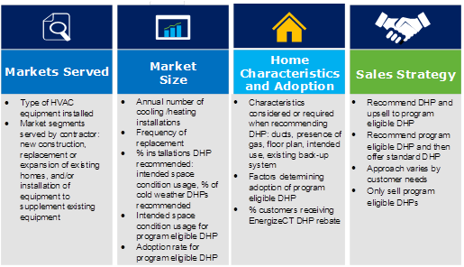
Methodology: Contractor Surveys

Slide 24
Methodology: DHP Adoption Model
Population Segments:
- Type of home: single vs. multi
- Pre-existing heating fuel type: electric vs. non-electric
- Intended use of DHP: cooling only vs. heating with/without cooling
DHP Participant Survey
- Asked significance of price of alternative fuels on decision to install HE DHP
- If alternative fuel price significant – likelihood of installing HE DHP if fuel prices were 20%, 33%, 50% or 75% lower
- Similar query for DHP program rebate levels

