Slide 1

Connecticut
R2023 RASS Enhancement
Database User Training
Presenters: Melissa Meek
October 29, 2020

Slide 2
Collected data
Delivered database
Enhanced database
R1706 / R1616
R2023
2018
2019
2020
History
2,426 web surveys
227 follow-up on-site verification visits
Case-level raw data
Analyses
Brief training
ENERGY STAR saturation
Efficiency levels

Slide 3

Refresher on database format
Highlight enhancements
Train users to navigate database
Today’s Objectives

Slide 4
Database Refresher

Slide 5
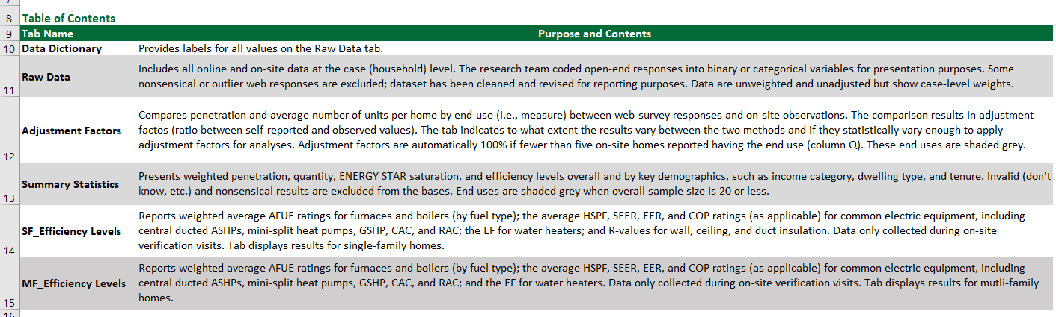
Database Structure
Six tabs including raw case-level data and analysis
Database Structure

Slide 6
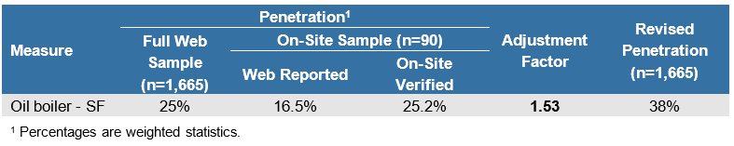
Saturation comparison of self-reports to observations
Indicators of customer knowledge
Adjustment factors can be applied to future self-report surveys
Adjustment Factor Example
Adjustment Factors

Slide 7
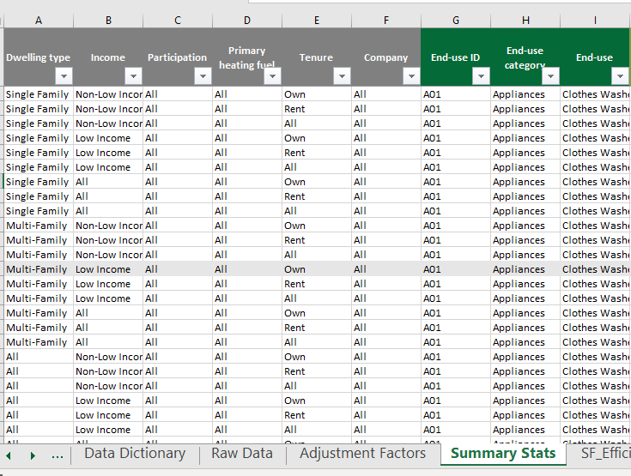
Cross-tabulations: 35 rows per measure
Statistics: Penetration, saturation, efficiency levels
Grey fill = low sample size
Summary Statistics Tab

Slide 8
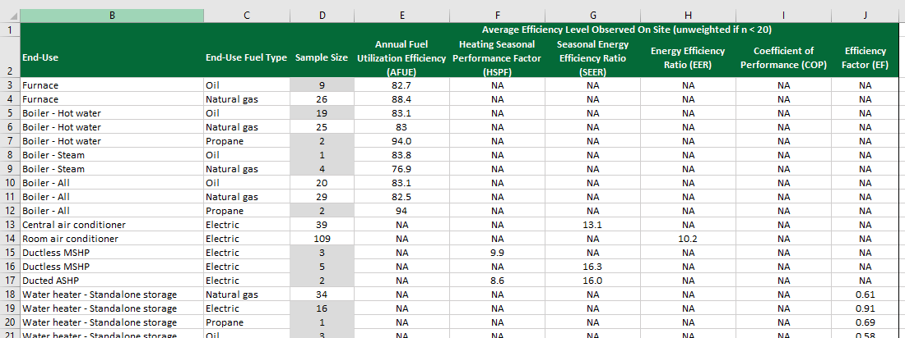
Efficiency Levels Tab
Tab with estimates of overall average efficiency estimates
Database Structure

Slide 9
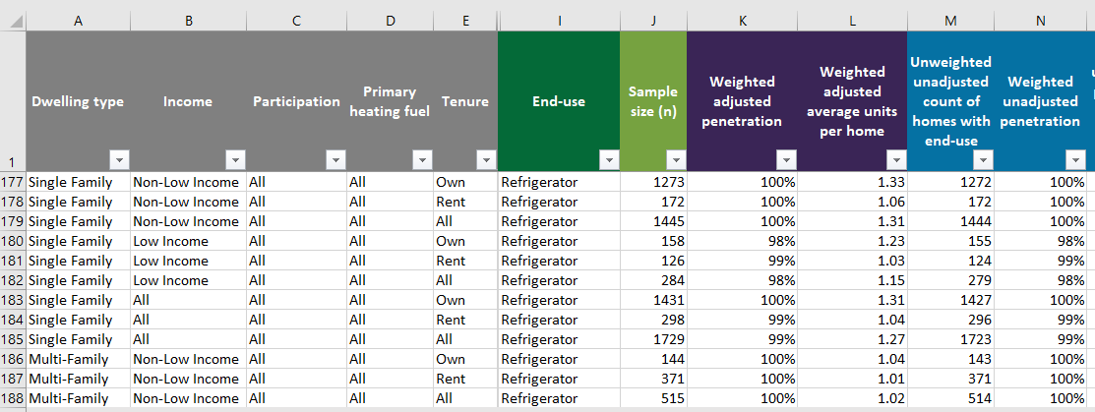
Penetration reported in the web survey
Penetration after adjusting for on-site results

Slide 10
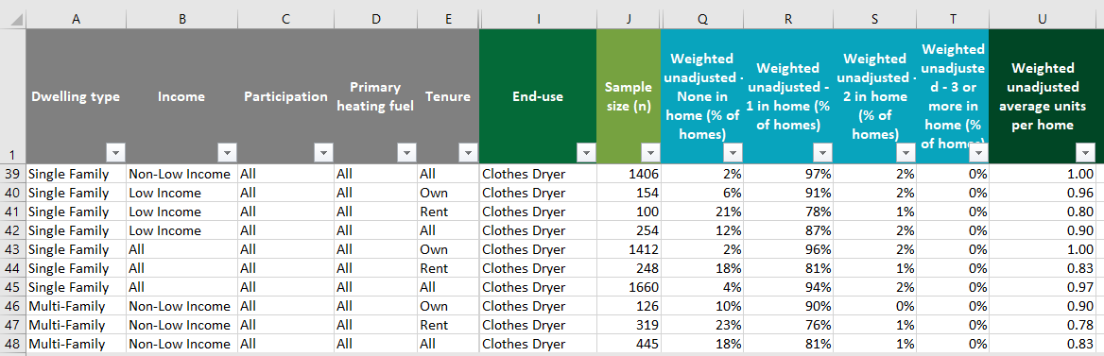
Quantity bins reported in web surveys
(e.g., what percentage of homes have 2 clothes dryers?)
Average quantities reported in web surveys

Slide 11
Database Enhancements

Slide 12
Stakeholders expressed interest in additional functionality and analysis during R1706 presentation:
  ENERGY STAR saturation
  Cross-tabulated efficiency averages
Ongoing goal in coming years: Keep database current and useful
R2023 Background

Slide 13
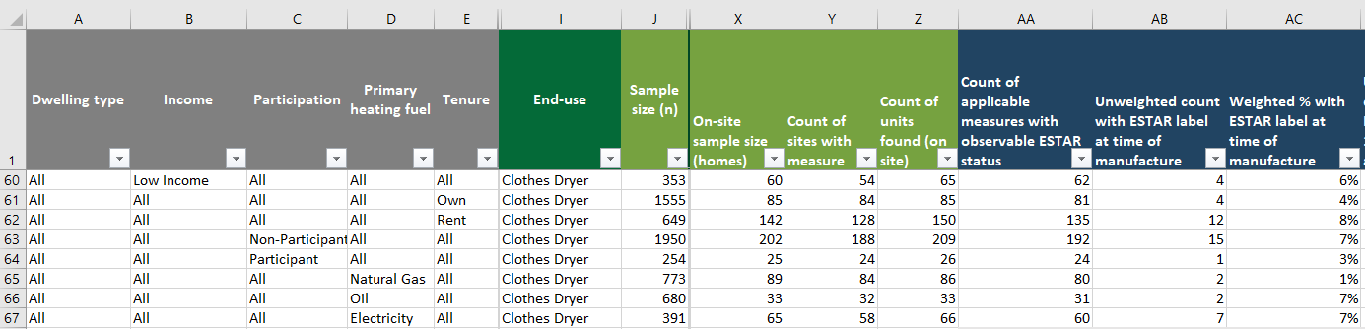
Counts of homes visited and quantities found
Overall ENERGY STAR saturation
i.e., percentage of units found with ESTAR label

Slide 14
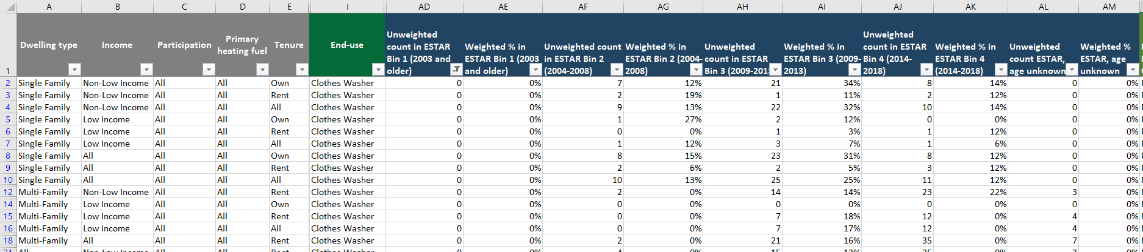
ENERGY STAR saturation by age
Use 4 age “bins” (i.e., ranges)
Percentage of units on site with ESTAR label and manufactured in <bin>
Unknown ages shown, too

Slide 15
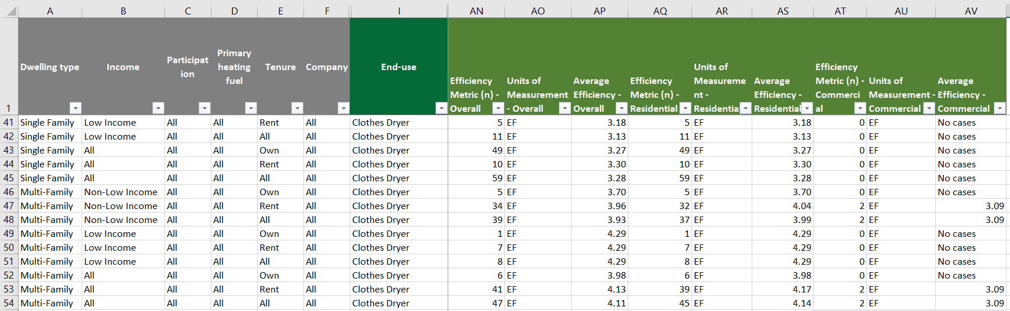
Average efficiency or consumption, split by sector

Slide 16
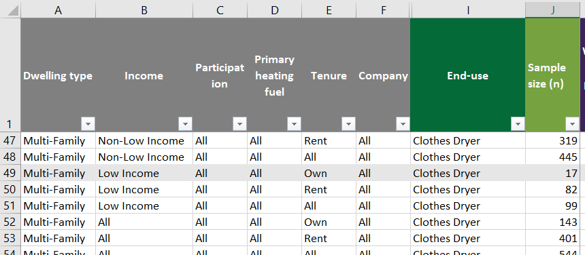
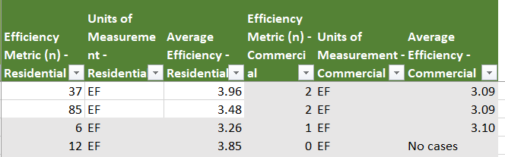
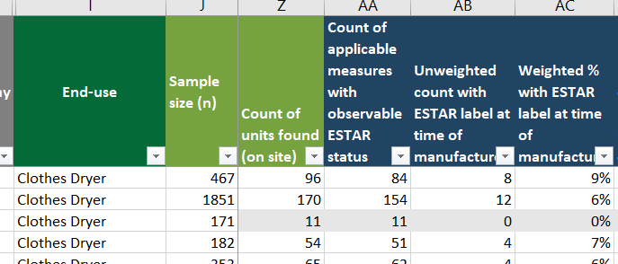
Why so many grey rows?
Few respondents in demographic group
Few units found on site
Few units of type

Slide 17
Further questions?
Melissa Meek
Project Manager
NMR Group, Inc.
Phone: 617-544-2024
mmeek@nmrgroupinc.com
Matthew Woundy
Research Analyst
NMR Group, Inc.
Phone: 617-544-2023
mwoundy@nmrgroupinc.com
Contacts

